Slide 1
Predicting best place to open business in Ottawa

Slide 2
Predicting business to open by neighborhood is very valuable to the owner
Generally opening a business include a lot of risks and making sure to open the business in the right area Is very important to reduce risks of losing the bushiness
Such value is recognized by the owner : lower the risk of closing
The business will be full of customers and very profitable business

Slide 3
Data acquisition and cleaning
Ottawa each neighborhood
Neighborhood each population
Longitude and latitude of each neighborhood and venues
All the venues by neighborhood

Slide 4
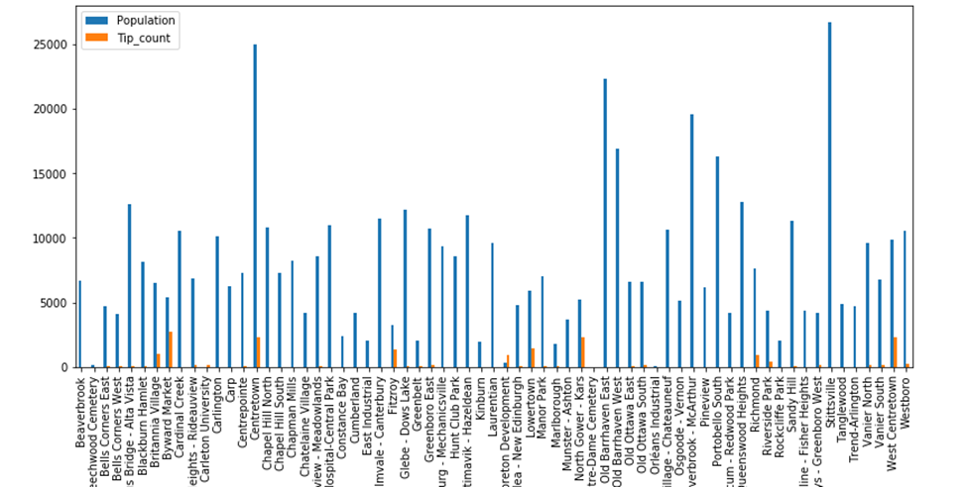
Using tips and population by neighborhood

Slide 5
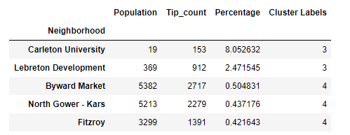
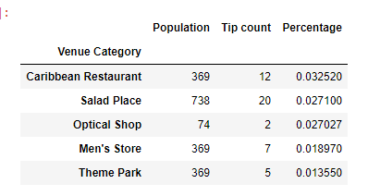
Table of best neighborhood to open a business and which category

Slide 6
Conclusion
In conclusion we fount the best area to open a business is in cluster 3 or 4 which they are have the highest percentage of tip count and it’s more likely to have your business to succeed.
As venue category Caribbean Restaurant and Salad Place are most likely to succed

